Slide 1
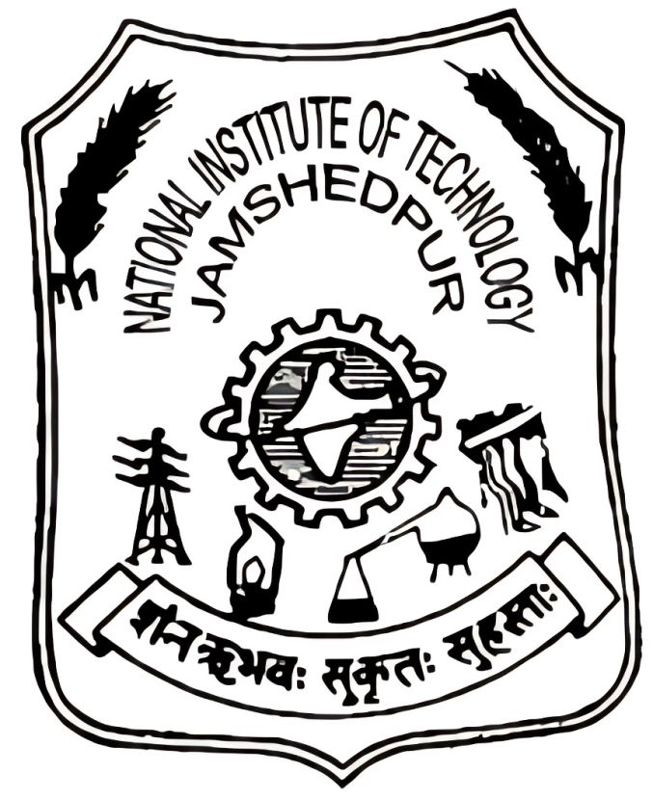
NATIONAL INSTITUTE OF TECHNOLOGY JAMSHEDPUR
TITLE OF THE PROJECT- SMART IRRIGATION SYSTEM
(CAPSTONE PROJECT I)
PRESENTED BY
SHIVAM KUMAR (2022UGCS030)
AMIT SINGH (2022UGCS057)
ADITYA KUMAR (2022UGCS075)
UNDER THE SUPERVISION OF
Dr. SUBRATA DUTTA
DEPARTMENT OF COMPUTER SCIENCE & ENGINEERING

Slide 2
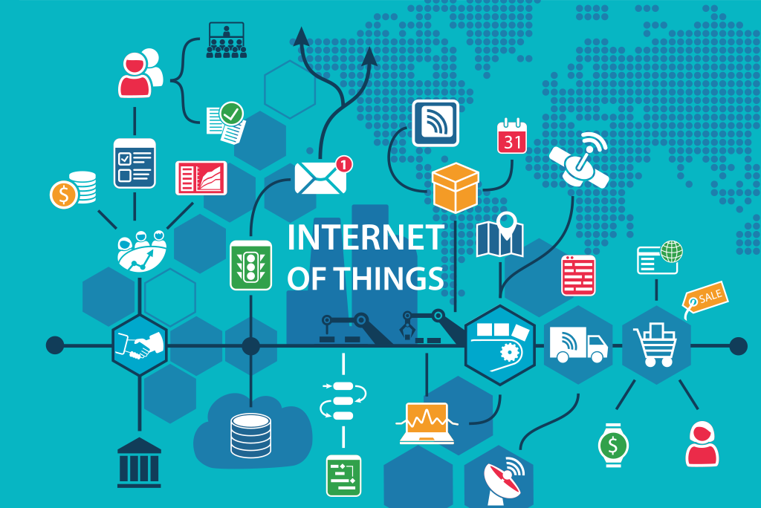
INTRODUCTION :
WHAT IS IOT?
The Internet of Things (IoT) connects everyday
devices, like sensors and appliances, to the internet.
This allows these devices to collect, share, and
process data in real time, making them smarter and more efficient
WHAT IS SMART IRRIGATION SYSTEM?
Our project, the Smart Irrigation System, uses IoT technology to monitor soil moisture, temperature, and humidity levels, automating irrigation to save water and reduce manual effort.

Slide 3
MOTIVATION:
Water Scarcity: Efficient water usage is crucial due to increasing water shortages. This system minimizes water wastage through smart irrigation.
Traditional Challenges: Manual irrigation is time-consuming, labor-intensive, and can lead to overwatering or underwatering. Automation simplifies the process.
Technological Advancement: Integrating IoT technology modernizes traditional farming, enhancing productivity and convenience.
Sustainable Agriculture: The system ensures crops receive the right amount of water based on soil moisture, promoting sustainable farming.
Cost Efficiency: This affordable solution makes advanced irrigation technology accessible to small-scale farmers.

Slide 4
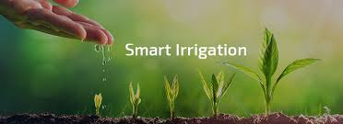
OBJECTIVES :
To develop an automated system that monitors soil moisture, temperature, and humidity using IoT technology.
To control irrigation based on real-time soil moisture , temperature and humidity.
To conserve water by providing irrigation only when needed.
To reduce manual effort in traditional farming and gardening practices.
To develop a cost-effective solution suitable for small-scale farmers and gardeners.

Slide 5
WORK METHODOLOGY:
RESEARCH AND PLANNING
PICK THE PROJECT
COMPONENTS GATHERING
CIRCUIT DESIGN
DOCUMENTATION AND PRESENTATION
TESTING AND CALIBRATION
SYSTEM INTEGRATION
SOFTWARE DEVELOPMENT

Slide 6
COMPONENTS REQUIRED:
Components | Purpose
ESP32 Microcontroller | Processes sensor data and controls the irrigation system.
Soil Moisture Sensor | Measures soil moisture levels to determine when watering is needed.
DHT22 Sensor | Monitors temperature and humidity in the environment.
Water Pump | Pumps water from the container to the plants.
Relay Module | Acts as a switch to control the water pump based on microcontroller signals.
Power Supply | Provides power to the system (e.g., rechargeable battery)
Jumper Wires | Connects the components on the breadboard.
Breadboard | Used for connecting components without soldering.
USB Cable | Programs and powers the ESP32 microcontroller.
Plastic Tubing | Directs water flow from the pump to the soil.
Water Container | Holds water for irrigation.

Slide 7
DESIGN:
SENSING SYSTEM
CONTROL
CIRCUIT
SOIL
WATER PUMP
POWER SUPPLY

Slide 8
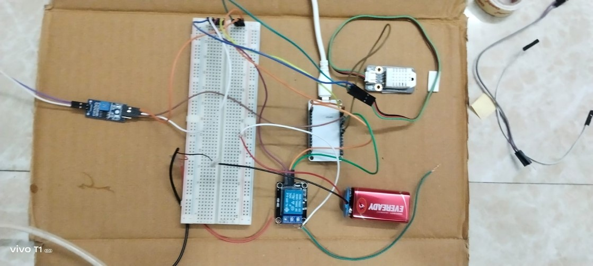
WORK PROCEDURE:
HARDWARE SETUP:
Connect the ESP32 microcontroller to the breadboard for easy wiring.
Attach the soil moisture sensor to the ESP32 to monitor the soil's moisture level.
Connect the DHT22 sensor to the ESP32 to measure temperature and humidity.
Wire the relay module to the ESP32 and the water pump, ensuring the relay acts as a switch to control the pump.
Place the water pump's tubing in the water container and direct it toward the plants.
Power the system using a rechargeable battery or connect it via USB to a power source.

Slide 9
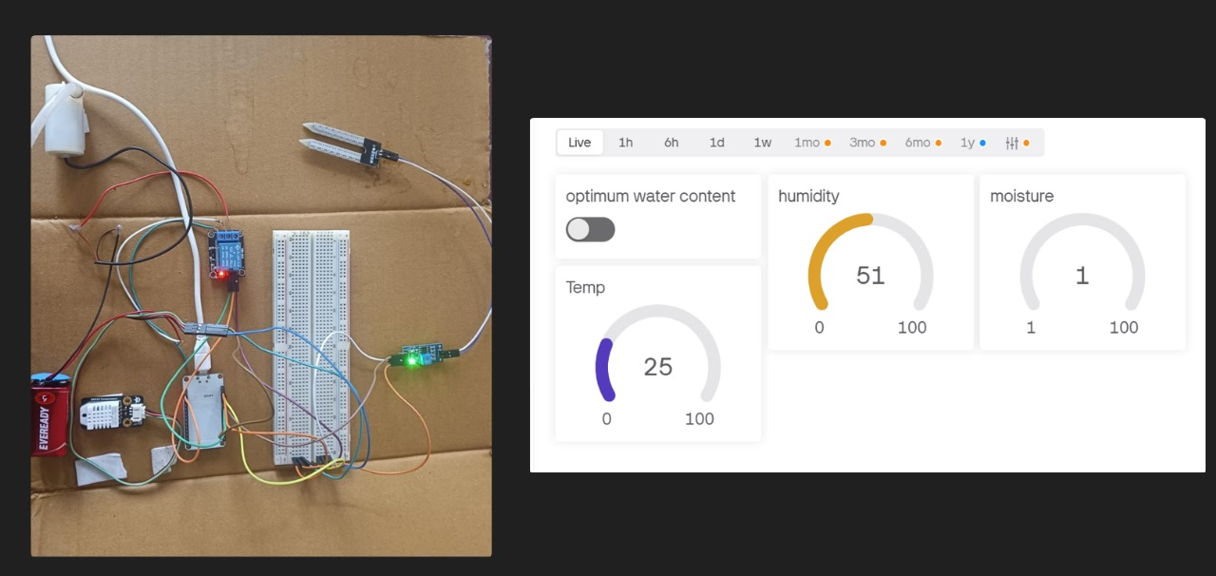
SOFTWARE SETUP AND BLYNK APP CONNECTION :
Program the ESP32 using Arduino IDE with Blynk, DHT, and WiFi libraries.
Write code to read sensor data and control the water pump via the relay.
Set up Blynk app: Create a project, add widgets (gauge for sensors, switch for the pump), and link with the ESP32 using the authentication token.
Connect ESP32 to WiFi for real-time monitoring and control through Blynk.
WORKING:
The system continuously monitors soil moisture, temperature, and humidity.
If soil moisture drops below the defined threshold, the relay activates the water pump to irrigate the soil automatically.
Real-time data is displayed on the Blynk app, and users can manually control the pump if necessary.

Slide 10
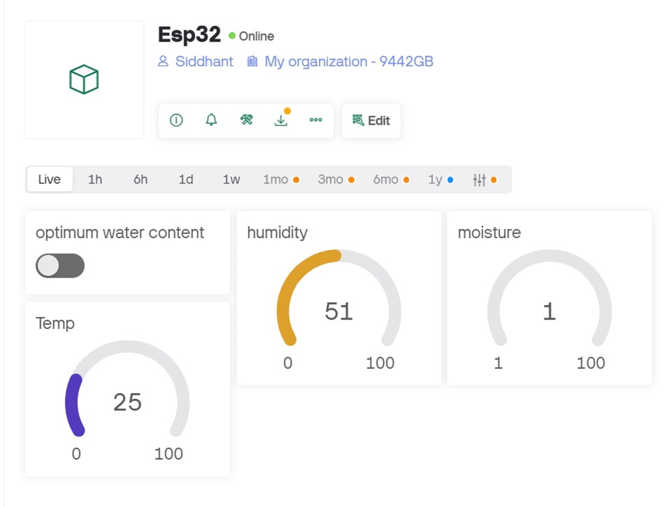
RESULTS AND OBSERVATIONS:
The observations from the results of Blynk app are as follows :
(IMAGE 1)
Temperature: Recorded at 25°C, indicating a
moderate environmental condition.
Humidity: Measured at 51%, reflecting
average air moisture.
Soil Moisture: Critically low at 1%, signaling
dry soil.
Optimum Water Content: Switch is off,
meaning there is no sufficient water.

Slide 11
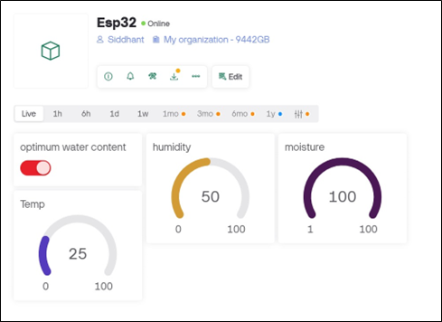
(IMAGE 2)
Temperature: Remained constant at 25°C.
Humidity: Slightly decreased to 50%, showing
stable air conditions.
Soil Moisture: Increased to 100%, confirming
successful irrigation.
Optimum Water Content: Switch is on,
resembling there is sufficient water for plant.

Slide 12
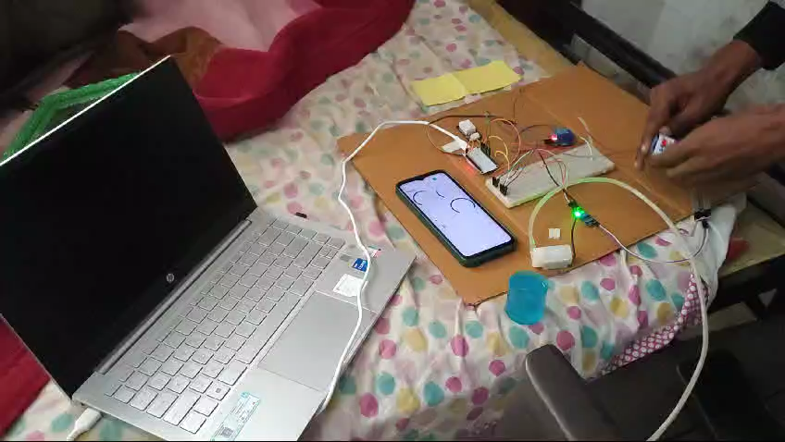
VIDEO DEMOSTRATION:
Here is the small working demo of our project:

Slide 13
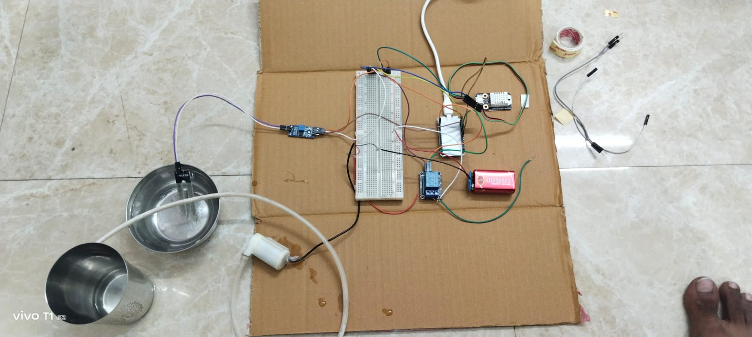
CONCLUSION:
The smart irrigation system using IoT was successfully developed to monitor and manage soil moisture, temperature, and humidity levels in real-time. It ensures efficient water usage by automatically irrigating when soil moisture drops below the optimum level, reducing water wastage and supporting eco-friendly practices. Overall, this project demonstrates the potential of IoT technology in creating sustainable and smart agricultural solutions, contributing to resource efficiency and better crop management.

Slide 14
FUTURE SCOPE:
Integration with Weather Forecasting:
The system can be enhanced by integrating weather APIs to optimize irrigation based on rainfall predictions and temperature changes.
Scalability for Large-Scale Farming:
The system can be scaled for use in large agricultural fields by adding multiple sensors and pumps to cover more extensive areas.
Renewable Energy Integration:
The project can incorporate solar panels or wind energy to power the system, making it eco-friendly and cost-effective in rural areas.
Automation in Fertilization:
The system can be extended to automate fertilizer delivery based on soil nutrient levels, further improving crop productivity.

Slide 15


